Slide 1
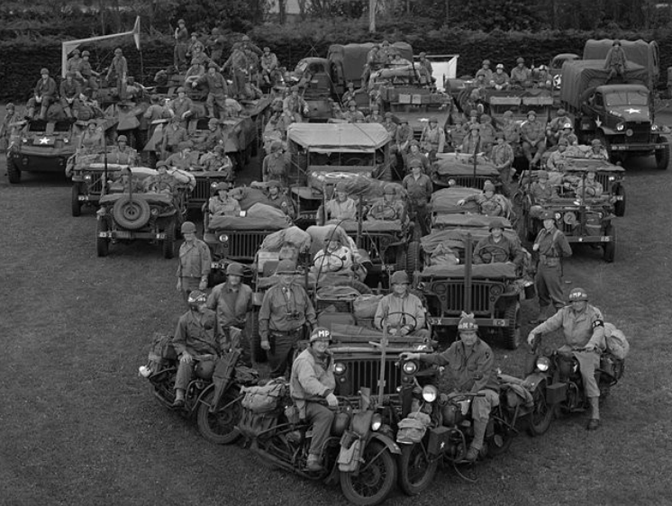
WWII CONVOY
WWII Convoy
Netherlands, 2012
Netherlands,2012

Slide 2
Goals
Travel the route of the 7th Armored Division
Full-on authenticity
Re-dedicate monuments
Ceremonies
Skirmishes

Slide 3
Convoy Make-up
40+ vehicles
2 Shermans
110+ re-enactors

Slide 4
Sleeping Arrangements
Pup tents
Bashers (lean-to off a vehicle)
Fox holes

Slide 5
Food
Plentiful breakfast and dinner
Lunch on the run as we pass through town. It usually gets skipped though as we’re constantly on the move.

Slide 6
Authentic Rations

Slide 7
Chow Line

Slide 8
And Authentic Cook Charm

Slide 9
German Cemetery Commemoration

Slide 10
Ceremony

Slide 11
Skirmishes

Slide 12
Museums

Slide 13
Patrol in Assault Boats
Pre dawn…
In the rain…
Yeah, it sucked.

Slide 14
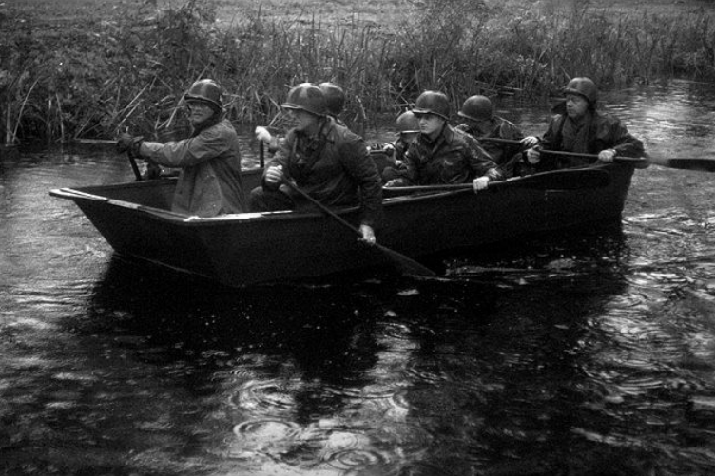
And it was the best of times!

Slide 15
Expect to ride in open vehicles

Slide 16
And be cold and wet

Slide 17
It’s not all work…we hit the bars

Slide 18
And made new friends

Slide 19
Costs
USD $650 to the convoy to cover food and fuel costs
USD $1500 for plane ticket.
Incidental purchases, such as trains to the rally point, ferry, bar tab, and souvenirs.
Garands are for rent for €150, about $200.
Figure $2500 to $3000 total.

Slide 20
Kit
Due to space limitations, each man is allowed one duffle bag. You don’t want to schlep more than that through the airport anyway.
Convoy will have a very specific list of what gear to bring so you exactly match the unit being portrayed.
Your usual unit and rank are left at home. You’ll be a private unless otherwise assigned.

Slide 21
Intercontinental Cooperation
No guarantees, but we’re working to see if most of the sleeping gear can be provided for the Americans so we don’t have to bring it through the airport. We hope to have trucks, drivers, and bashers assigned to our section.

Slide 22
2014 Details
Ten day trip through France into Belgium to commemorate the 70th anniversary. [Edit: trip has been increased to 10 – 12 days.]
Over 100 vehicles on convoy. Fifteen tanks and twenty halftracks have already signed on.
Would like 400+ re-enactors, including at least 75 Americans. [Edit: 70 people have signed on as of January, 2013.]

Slide 23
Expectations
You can expect to be cold, wet, hungry, and sleep deprived.
And expect to make new friends and have the time of your life!
This is an experience you can’t get anywhere else.

Slide 24
More Information
http://www.2ndarmoredineurope.co.uk/
U.S. coordinator Tom: tsmgm1a1@aol.com

Slide 25
Presentation built by Todd Hintz 105th Engineers, 30th Division www.105th.org

